Slide 1
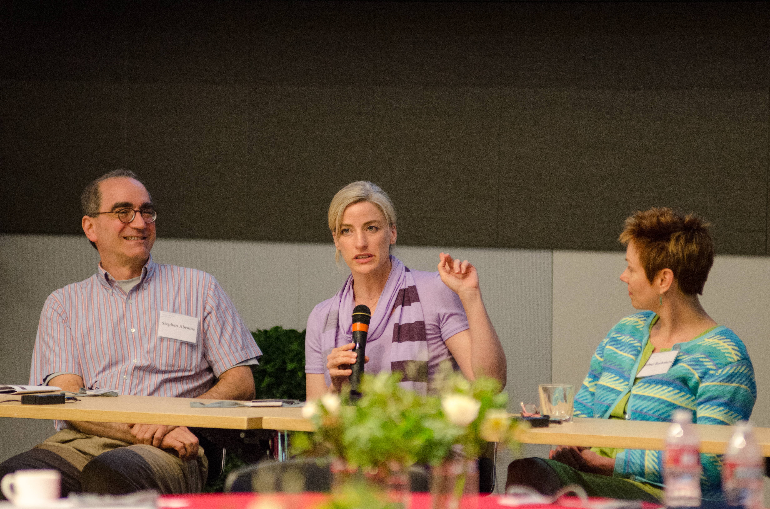
Data Services
Amy Hodge
SERG Retreat, Aug. 9, 2013

Slide 2
Forum on the Future of Scientific Publishing A brief, brief, brief history
Ongoing discussions on data access & publishing and the future role of libraries in these areas (Julie, Tom, Amy).
Early May: Faculty meeting where discussion devolved into one about open access, research data, and the OSTP memo (Tom Baer, Bruce Clemens, Bob Byer, & others).
May 8: Workshop is proposed. Stanford Libraries, Dean of Research, & society publishers agree to participate.
May 17: First organizational meeting held (Amy, Julie, Bob S., Tom, Bruce, Sara).
June 27: Forum is held. Urgency in timing is due to the Aug. 22 deadline for draft policies.

Slide 3
Forum on the Future of Scientific Publishing In a Nutshell
OSTP Memo
Digital data from federally-funded research projects should be made publicly accessible
Agencies must develop plans by Aug. 22 to increase public access to publications and scientific data
National Science Foundation
Open Access to Manuscripts, Future of Publishing
SHARE, CHORUS, OSA, APS, Elsevier, PLOS
Open Access to Research Data
Executable Paper, data policy, what libraries are doing (UC3, Stanford, Columbia/CIESEN), researchers

Slide 4
Forum on the Future of Scientific Publishing Takeaways
Tons of positive feedback
Many were unaware all this activity was going on at the Federal level
People were much more comfortable discussing the publishing topic in the morning
Data discussion in the afternoon generated more questions and uncertainty

Slide 5
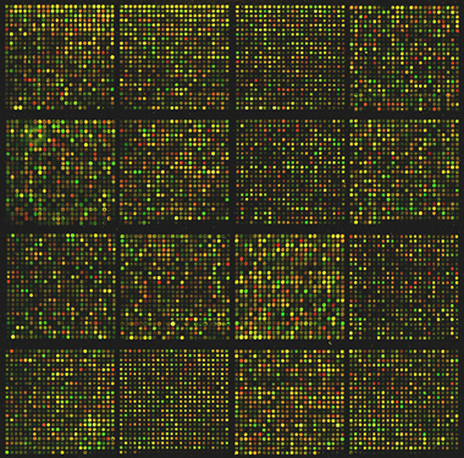
Forum – Future Focus
Custom Portal
???
SUL
everyone’s data together
very explicit metadata requirements
SDR
highly customized search
tons of SUL labor
Notes:
This is where the biggest questions still are
This is where we see the best fit for libraries, including SUL, in the future
This fits how we are already positioning ourselves, particularly with respect to the SDR
Work with the faculty to define pockets of where there are data that would be really useful to have aggregated all together but currently are not and developing the system for that and the metadata standards, etc.
We are working on a system like this now – the geoportal.

Slide 6
Data Services: A Recent History
or “The Data Evangelist”
Notes:
From here I want to step back for a few minutes an d recap my 13 months so far at SUL, and then I’ll circle back around to where I see the future in more detailed terms.

Slide 7

The Data Evangelist
approved by MAK
June 30
& web site launch
1st Contact: Hatef
Outreach Blitz
4 SUL presentations
7 Public workshops
2 SUL News articles
constantly talking with different individuals and groups about data
Open Access @ Med School with Tom and Mimi
1st data PURL in test @ Asilomar monthly meeting
Email to Eng. Research Administrators
Jan. 1
Email via DoR Office to research grant administrators list
DMPTool users & web site visits
6 Stanford Report ads run
DMPTool updated with med school info
Release of new DoR web site
Hopkins mini deposit-a-thon
SDR Deposit of the Week series launches
SDR Deposit of the Week
Data Services Newsletter launches
SDR Deposit of the Week
New Microsite plan conceived
Newsletter
Data Disaster article published
SDR Deposit of the Week
Dean of Eng’s Executive Committee Presentation
Newsletter
FAQ Published
Newsletter
FORUM
SDR Deposit of the Week
Newsletter
SDR Deposit of the Week
August 9
Notes:
Ads & Newsletter > easy to measure responses on some level, responses to call for software testers
About the SDR Deposit of the week blog posts: staff awareness
Paraphrasing Joseph Makokha: "Keep doing those posts because unless you are invested in a project, how do you know what else is going on around here? When you get the email announcing the post, you are reminded that this is possible. It is useful not only as a content producer, but also as a way of discovering someone else's new content. It makes me say 'wow.' "
Paraphrasing Elijah Meeks: "I get the tweets about the release of the week, and I say to myself, 'I want to be one of those' "

Slide 8



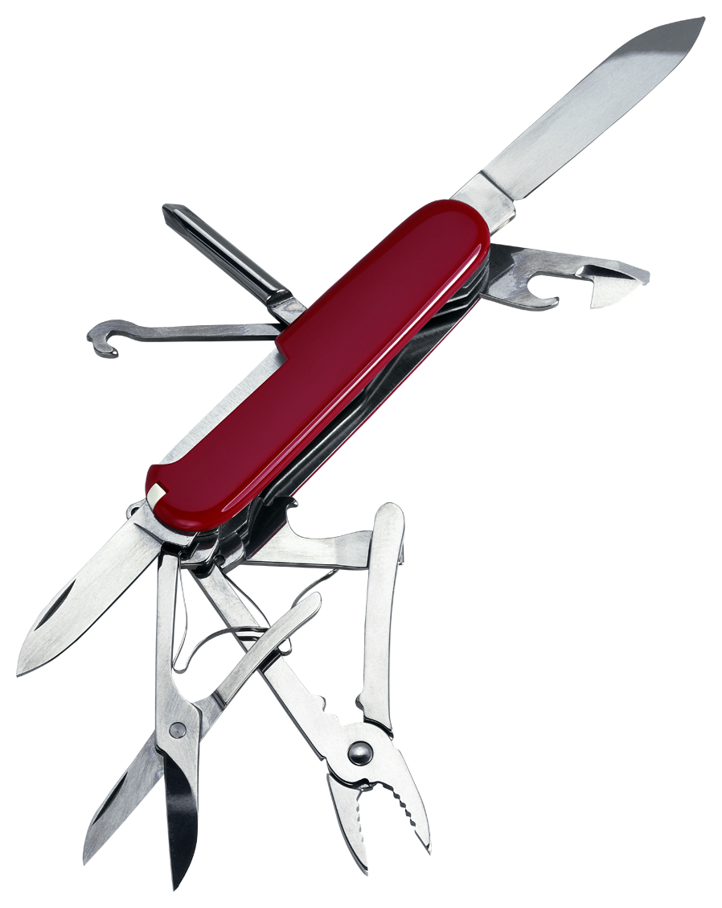
Lessons Learned
It’s hard to get the word out
A week ago, David Goldhaber-Gordon
One-on-one conversations work well
They tend to pass things on: David Donoho, Greg Deierlein
“Just in time” is important
Hatef’s & Sridharan’s Google search
Deborah Gordon’s DMP
Many avenues produce noticeable results
The best avenue is you!
Photo by MyDigitalSLR

Slide 9
Future Evangelism
Newsletter & Deposit of the Week will continue
Talking to anyone, anywhere, anytime
Self-deposit concierge (Sep)
DIG workshops on data management (Oct/Nov)
Workshops on best practices for your data (Oct)
Possibly a workshop on metadata tools for biology (Nov?)
ReNUWIt last Wednesday, VPOL next Wednesday
Practical information (FAQ, backup & storage)
Metadata tools
SDR “quick guide”
Best practices
Software Carpentry boot camp (early winter)
“Just in time” projects
Timed Stanford Report ads for DMPTool (Aug/Sep)
PNAS authors project (fall)
Projects software testing
A simple approach to improving your ability to sort through your data and find things

Slide 10
Approaches to Data
Self-deposit
Personal Portal
Custom Portal
individual data
individual data
everyone’s data together
no metadata requirements
self-defined metadata
very explicit metadata requirements
SearchWorks & direct links
simple but customized search
highly customized search
minimal SUL labor
some SUL labor
tons of SUL labor

Slide 11

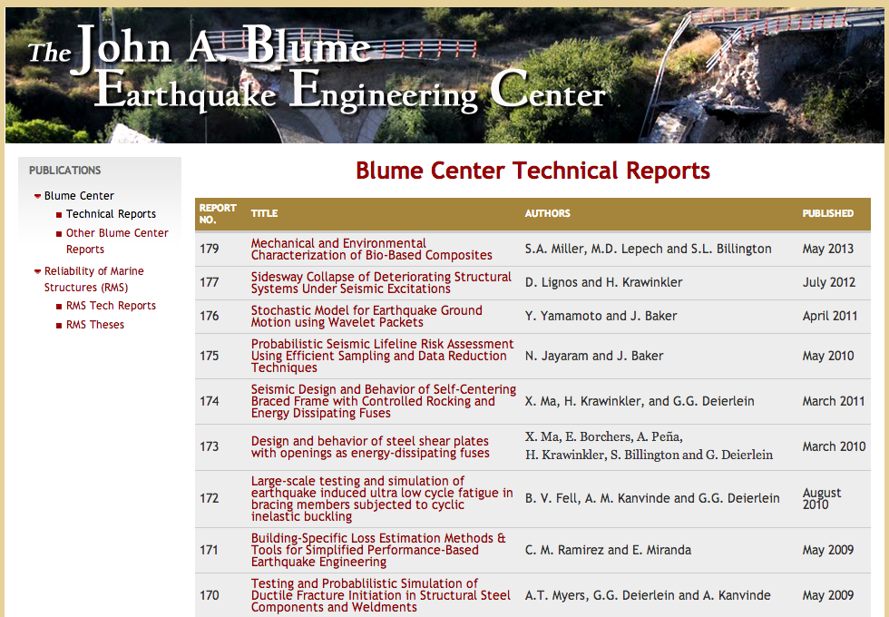
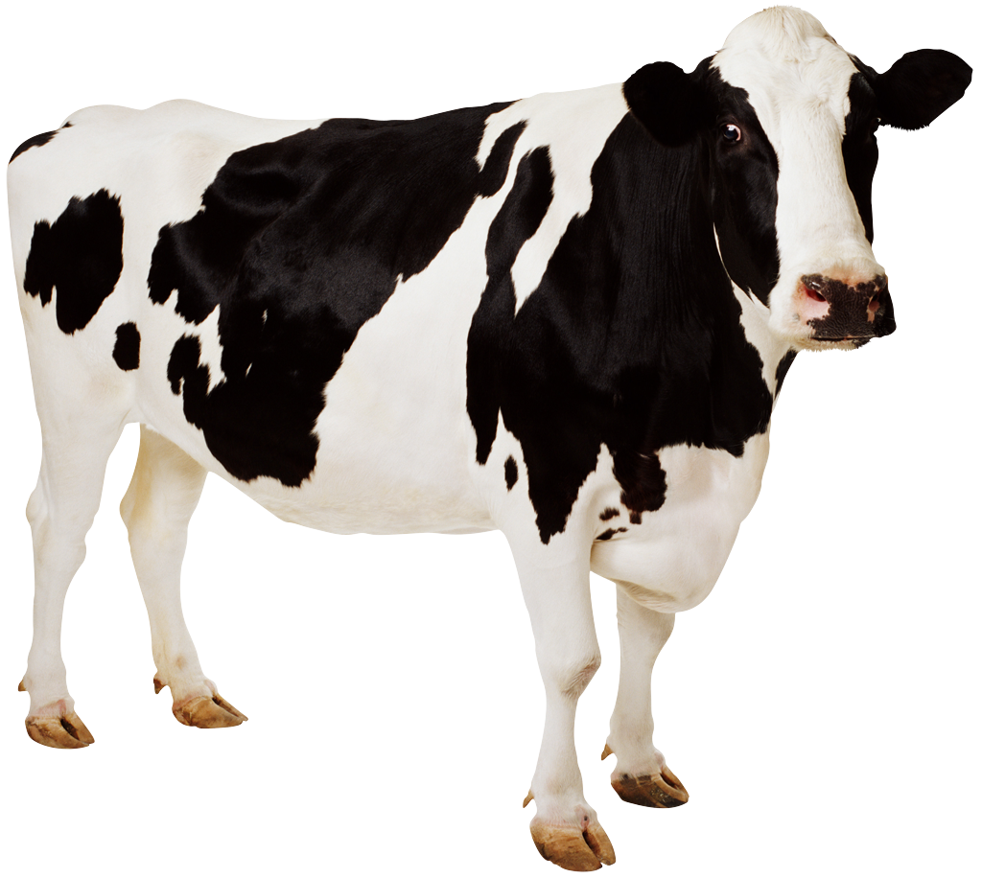
Deposit Party

Slide 12
How People Find the SDR
Bog
SUL Staff
Presentation
Email/Newsletter
Colleague
Web Search
Notes:
Staff Examples:
Mimi @ reception with Tino of FSI
Kim over cookies with Simon
John Sack in mtg. with Michael Osborne
Julie and I contacted Richard White @ Railroaded, and ended up with Slave Markets in Rio
Peter’s wife

Slide 13
Marguerite [Data] Minute or things to listen for on the bus
I’m concerned about what is going to happen to...
when...
my student’s data...
our tech reports...
these great class projects...
our collaborative research...
they graduate.
I retire.
the term is over.
the grant ends.

Slide 14
Marguerite [Data] Minute or things to listen for on the bus
I need a way to get my data to someone else.
I need somewhere to put data for safekeeping.
I’m not sure what to do with the data for my project.
I’m not sure what to do for this data management plan.
I’ve been looking into AWS, but it makes me nervous (or I can’t sort it out or whatever).
It’s getting hard to keep track of things in our lab.
Our students/post-docs/staff need some help with best practices.
I need somewhere to put my supplemental data.

